Slide 1
Texas A&M University-Texarkana
TouchNet Marketplace Guide

Slide 2
What is Marketplace?
It is a solution for creating, managing, and operation online stores and products
Marketplace allows you to sell tickets, promote events, and much more.
Shoppers can use one shopping cart and a single checkout from multiple stores, while you feed all their transactions to your correct account in FAMIS/Canopy.
Processing is PA-DSS (security controls implemented in the software)
Viewable reports on demand

Slide 3
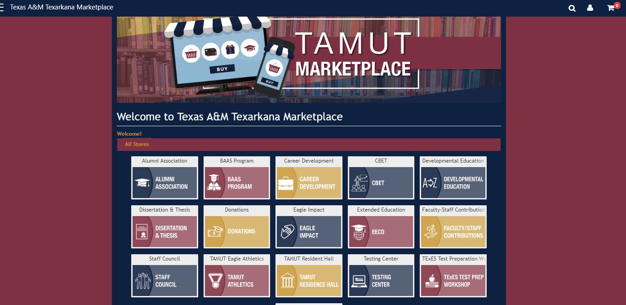
Marketplace Mall Front - Homepage

Slide 4
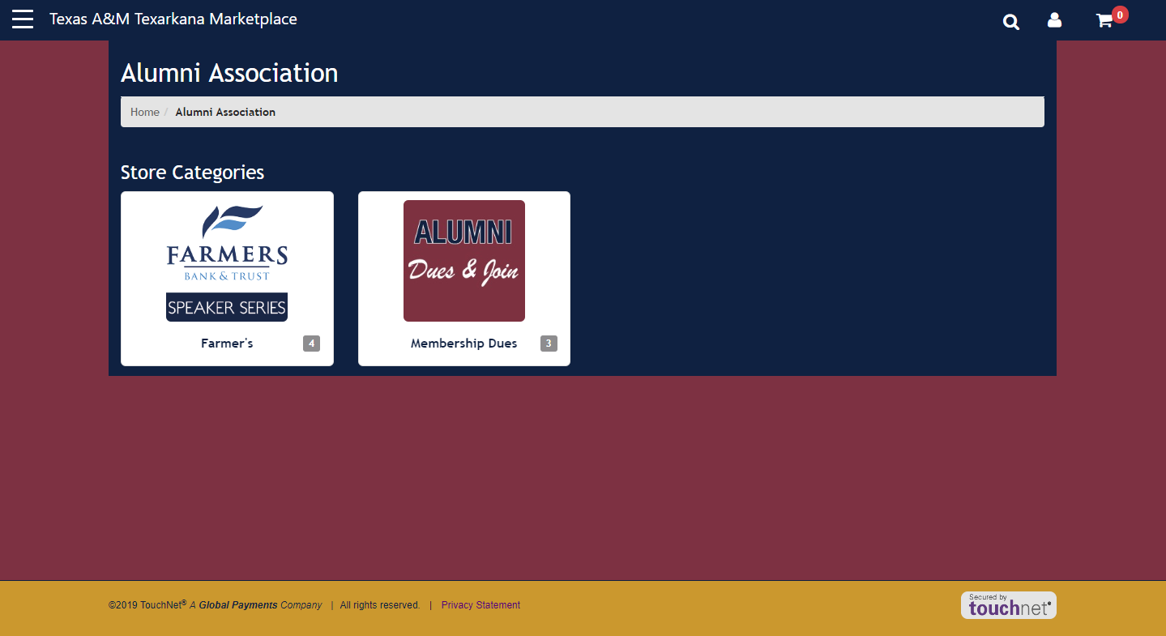
Store Category Homepage

Slide 5
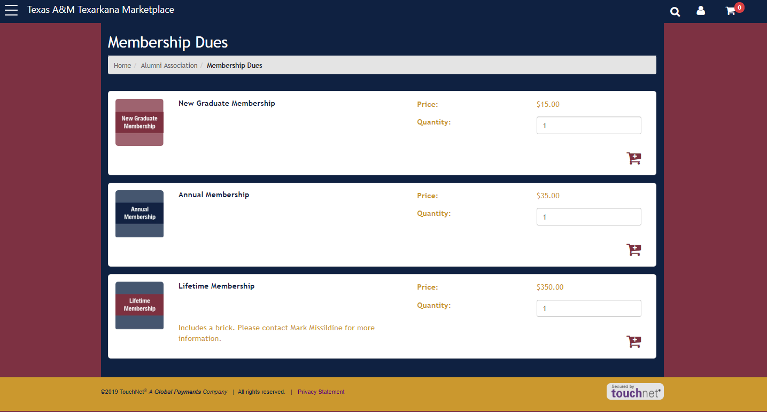
Products within Category

Slide 6
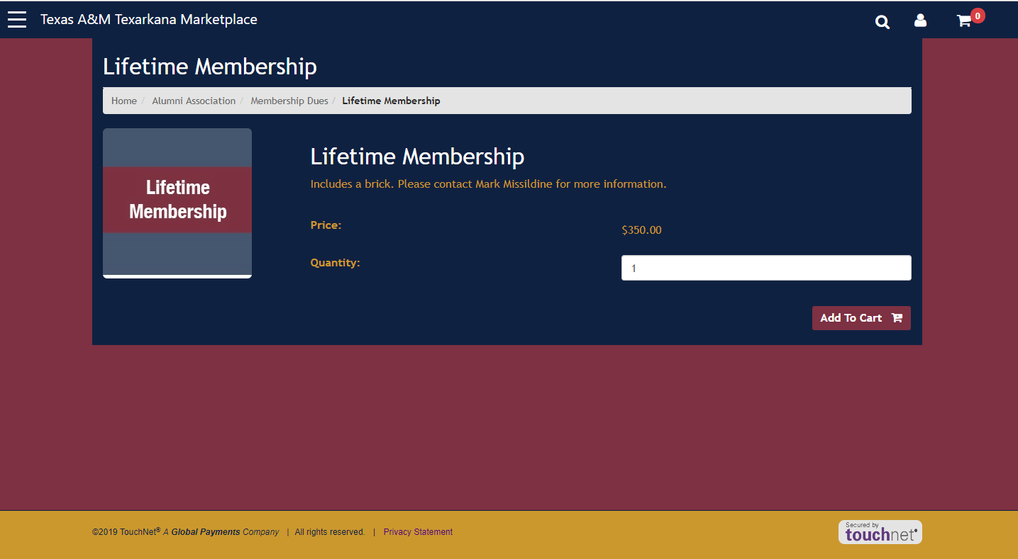
Product Item Homepage

Slide 7
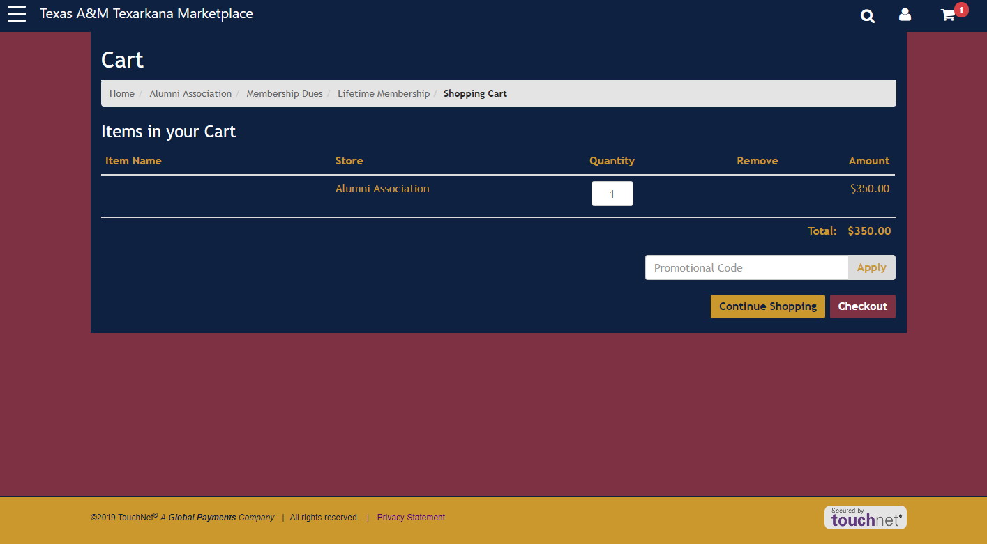
Shopping Cart

Slide 8
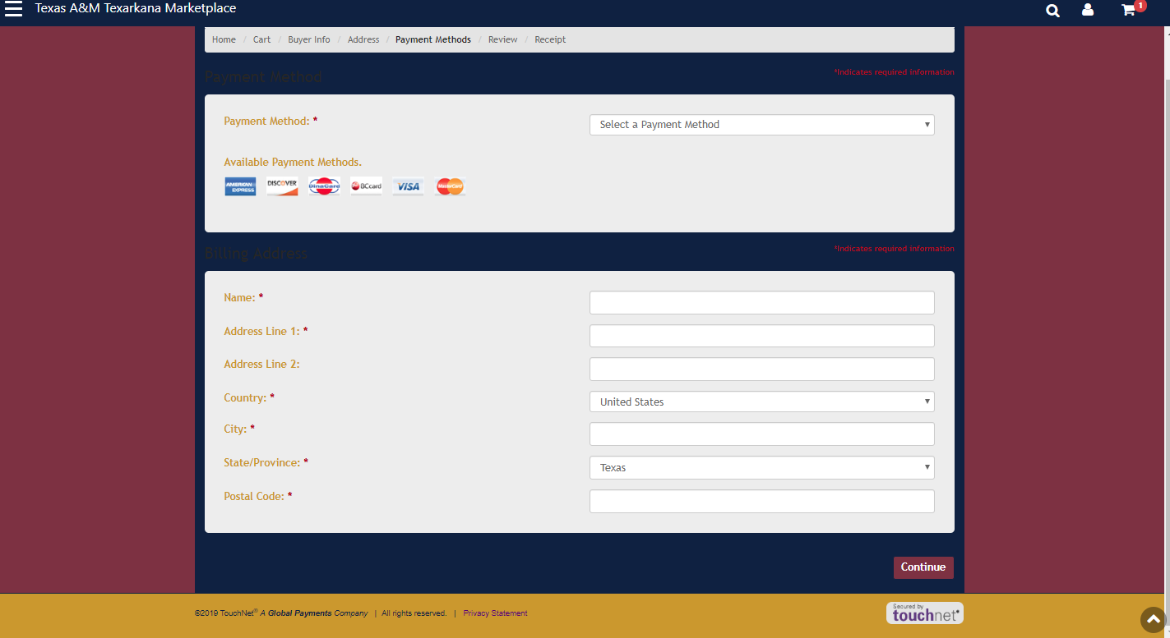
Checkout

Slide 9
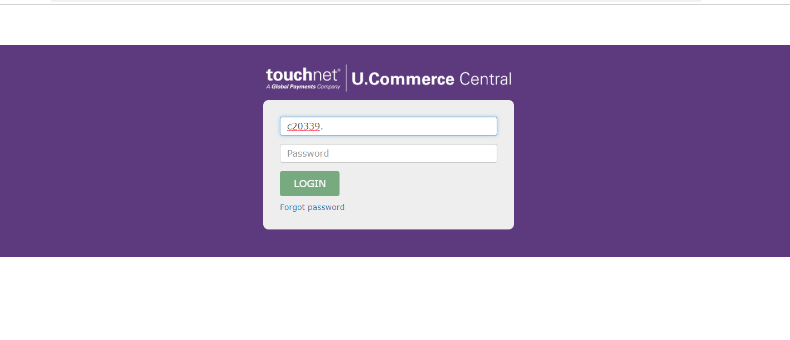
TouchNet Login

Slide 10
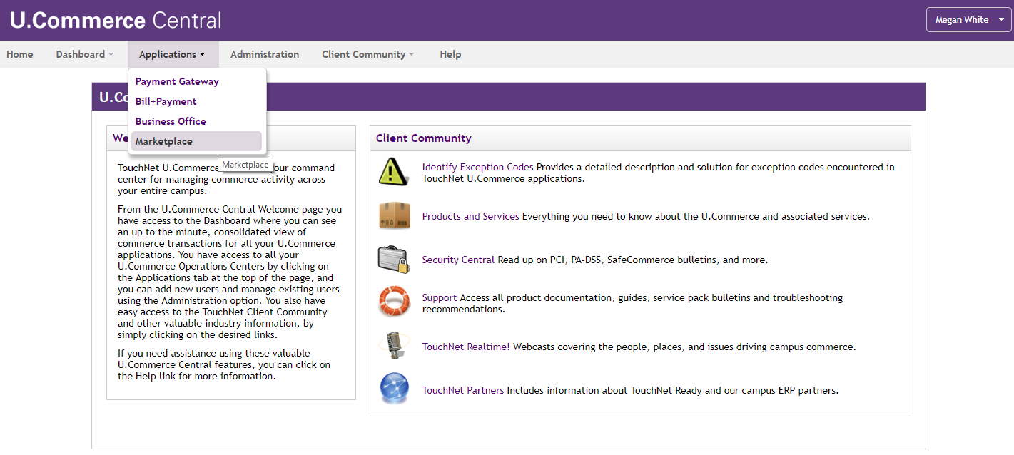
TouchNet Reporting

Slide 11
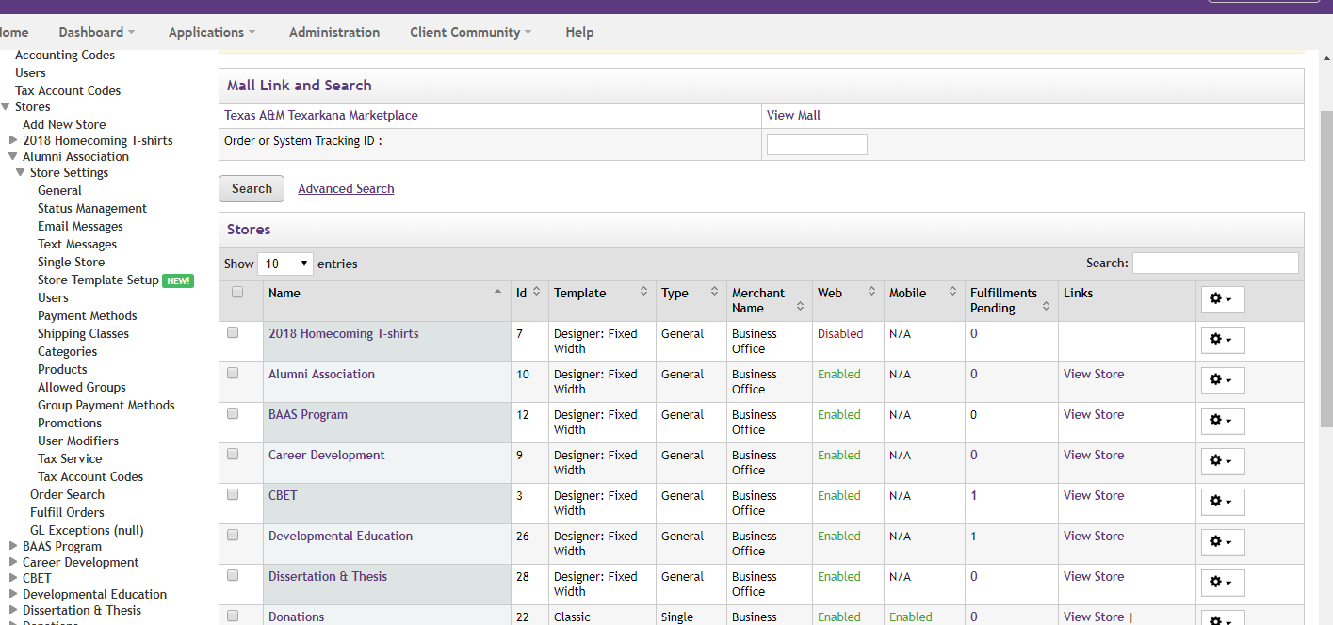
TouchNet Reporting

Slide 12
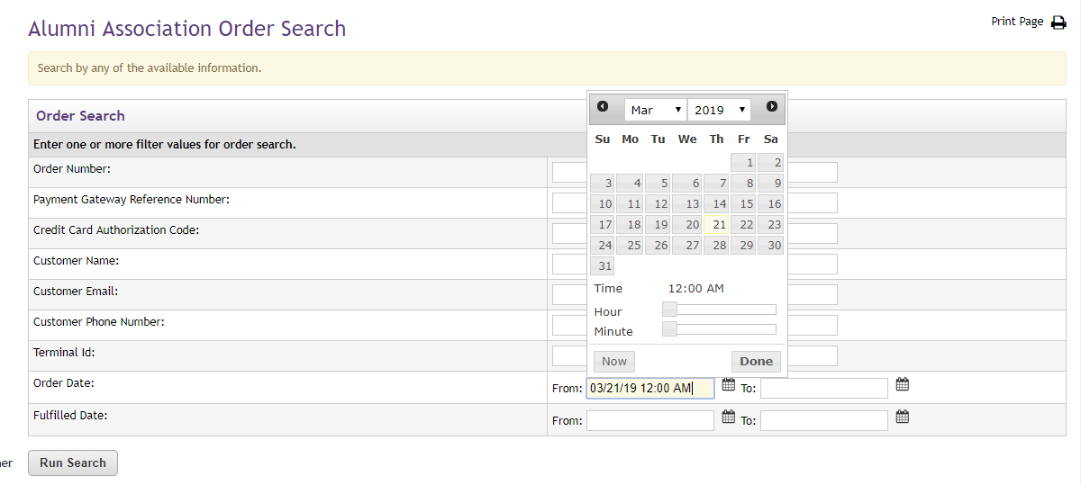
Store order search

Slide 13
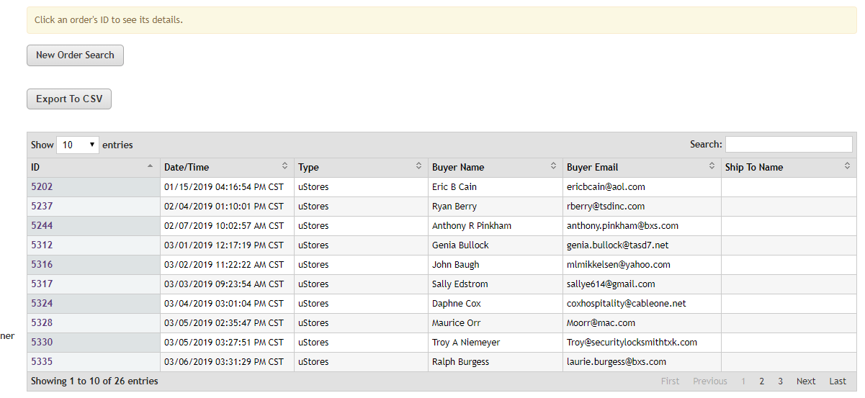
Report Results

Slide 14
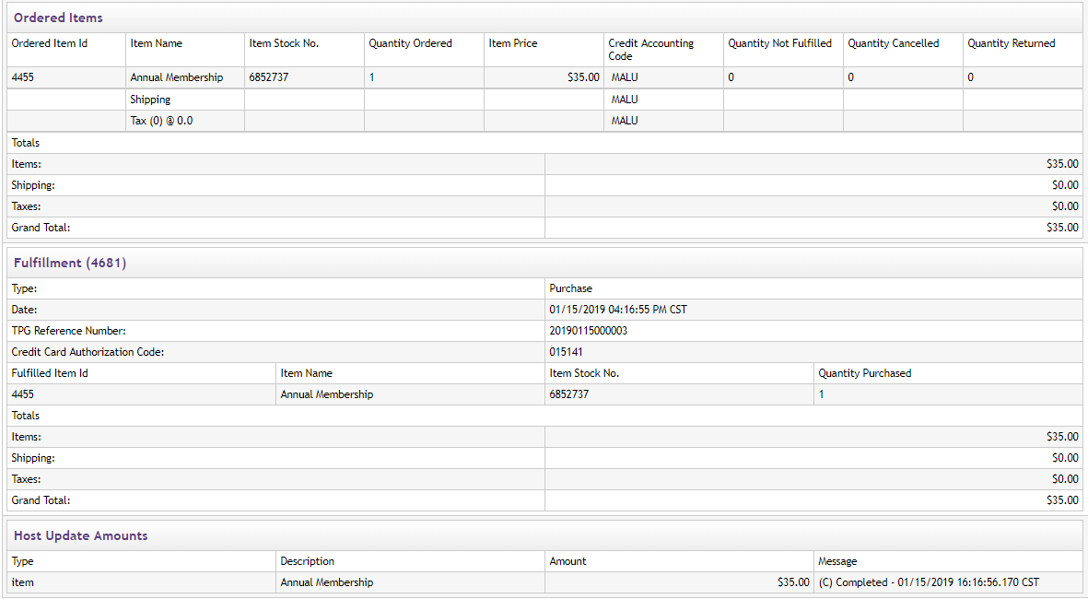
Order Details

Slide 15
Marketplace Features
Track Inventory- restrict sales to inventory
Allow recurring payments/donations
Reports downloadable in Excel
Refunds directly from Marketplace (refund form)
Products can be enabled or disabled by calendar dates

Slide 16
How to Request a Store?
Email the store request form to ecommerce@tamut.edu
Email the store specification form to megan.white@tamut.edu
Email the security form to ecommerce@tamute.edu
  This form is for new users

Slide 17
Graphic Button specifications
Category image : 400 x 400 pixels
Product image : 400 x 400 pixels
Store mall image : 190 x 90 pixels
Hero store image : 1140 x 320 pixels (image at top of store page)

Slide 18
Modifiers
This is all information needed from the purchaser
  Name
  Email
  Phone number
  Address

Slide 19
Fulfillment & QR Code
You may choose to not have products fulfill automatically
Non auto-fill products must be fulfilled by the requesting department
If you would like a QR code, please make note on your product request form

Slide 20
TouchNet Forms
New Marketplace Request Form
Marketplace Store Information Form
TouchNet Security Form
Refund Request Form

Slide 21
Object Codes
You may check the TAMU object code website OR the taxable object codes list

Slide 22
Taxable Items
Taxable Items: A tax must be collected on all sales involving tangible, personal property. The State Comptroller defines this as personal property that can be seen, weighed, measured, felt or touched, or that is perceptible to the senses. See Texas Tax Code Section 151.009
  Clothing
  Computer Programs
  Meals
  Books
  Equipment Rental

Slide 23
Taxable Items
A tax must be collected on all taxable services. See Texas Administrative Code on State and Local Sales and Use Taxes
  Amusement Services
  Information Services
  Internet Access
  Laundry Services

